Slide 1
Comparing Top Venues in Toronto and New York

Slide 2
Business Problem
Similarities and differences between the two financial centers of Toronto and New York
Identify the top trending venues in each city
Top venues reflects the habits of residents and potential investment opportunities for entrepreneurs

Slide 3
Data Source
City of Toronto Open Data portal
2016 Neighborhood Profiles data
New York University Spatial Data Repository
2014 New York City Neighborhood Names

Slide 4
Methodology
Use summary statistics to describe the top trending venues in both cities
Machine learning algorithms to cluster similar neighborhoods together and identify common characteristics:
K-Means Clusters
DBSCAN

Slide 5
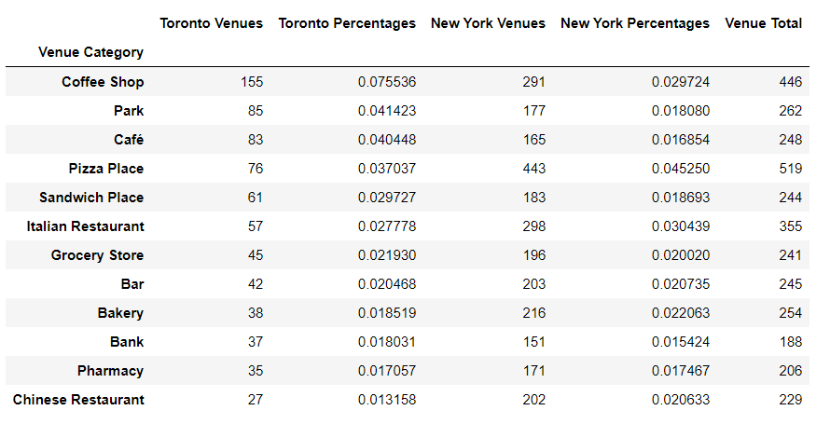
Most Common Venues in Toronto and New York

Slide 6
Most common venues are food and beverage related
Coffee houses
Pizza places
Cafes
Sandwich places
Ethnic restaurants
New York: more preference towards pizza places and restaurants
Toronto: more preference towards coffee houses and sandwich places

Slide 7
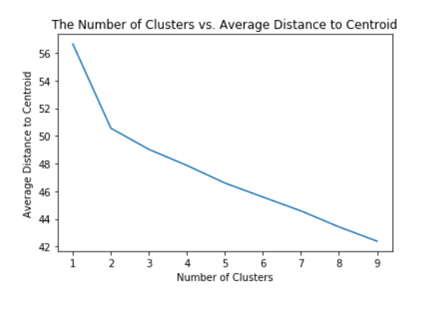
K-Means Clustering
Cluster data based on the average distance between data points in a cluster and the “centroid”
The “elbow method” indicated there should be 2 clusters
Most clusters would make the clustering more accurate, but takes up more processing power

Slide 8
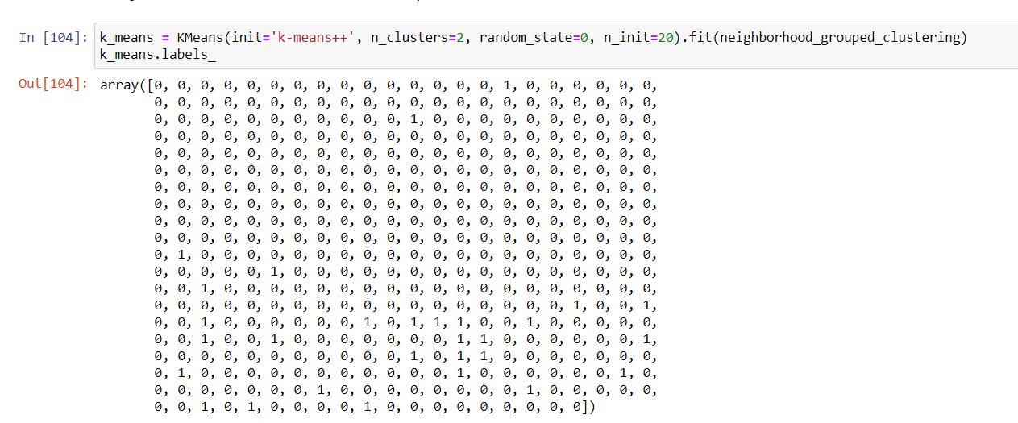
K-Means Results
Most common venues in Cluster 1
Venue Category | Venue
Park | 41
Playground | 5
Pool | 4
Moving Target | 3
Tennis Court | 3
Bus Stop | 3
History Museum | 3
Cafe | 3
Construction & Landscaping | 3
Dog Run | 2
Notes:
Two clusters of venues: Cluster 0 and Cluster 1.
Cluster 0 comprised the majority of the neighborhoods, and is reflective of the overall distribution of venues.
Cluster 1 is heavily Toronto biased. The most popular venues in Cluster 1 are recreational activities.

Slide 9
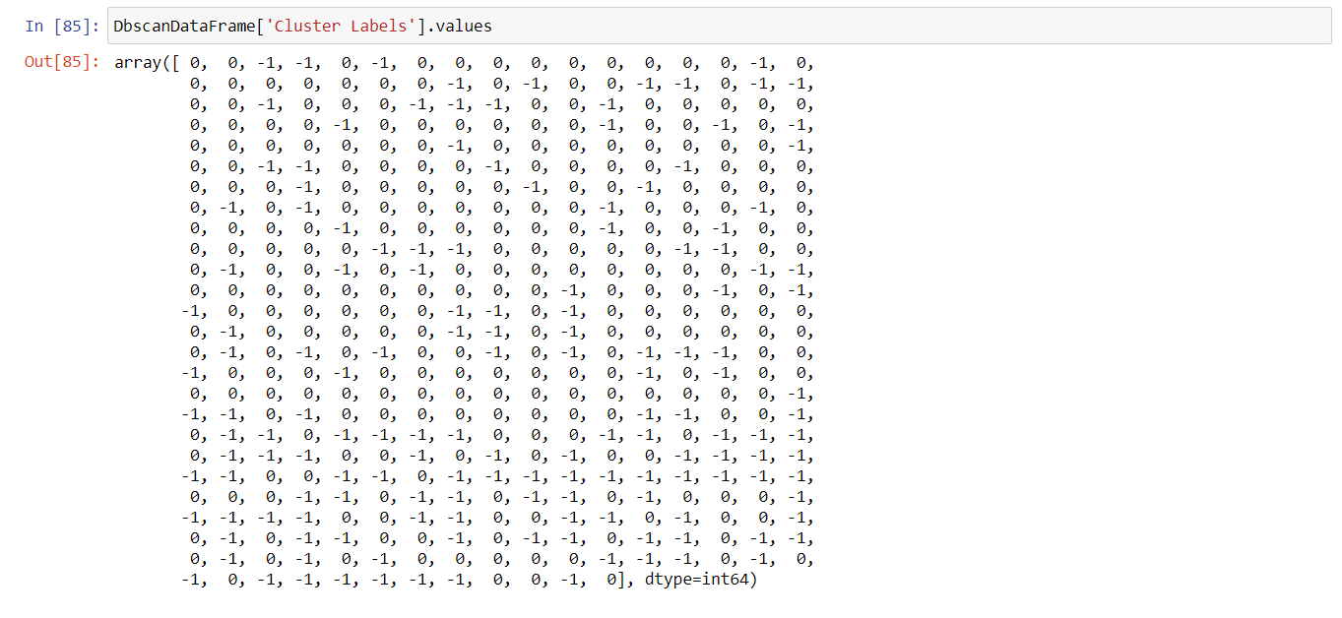
DBSCAN Results
Radius of 0.3 and threshold of 7
Only 1 cluster was identified (“Cluster 0”)
Remaining neighborhoods were considered to be outliers
Cluster 0 was broadly reflective of the overall types of venues present in both cities

Slide 10
Considerations and Conclusions
Food related venues were broadly the most common venues in both cities
Fast food places were relatively more common than restaurants
Some neighborhoods had recreational facilities as the most common type of venues
Be aware of venue saturation, and the diverse preferences in different neighborhoods
Future studies should use number of visitors to better reflect trends

